Slide 1
Lesson 1.3
JS Functions and Arrow Function Syntax

Slide 2
Learning Outcomes
Explain how JS executes functions

Slide 3
Important Terms
Parser
A parser is a program that reads your code line-by-line.
It understands how the code fits the syntax and what the code is expected to do.
JavaScript Engine
A JavaScript engine is simply a computer program that receives JavaScript source code and compiles it to the machine code that a CPU can understand.
JavaScript engines are typically developed by web browser vendors, and each major browser has one.
Global Execution Context
This is the default execution context that the JavaScript engine creates when it receives a script file.
Where all JavaScript code that is not inside of a function gets executed.
For every JavaScript file, there can be only one Global Execution Context.
Function Execution Context
Whenever a function is called, the JavaScript engine creates a Function Execution Context within the Global Execution Context to evaluate and execute the code within that function.
Every function call gets its own Function Execution Context.

Slide 4
Important Terms
Execution Stack
The execution stack keeps track of all the execution contexts created during the life cycle of a script.
Also known as a Call Stack.
Stack Overflow
A call stack has a maximum size allowed.
Stack overflow is an error that occurs when a computer program tries to use more memory space in the call stack than has been allocated to that stack.
A stack overflow is often caused by poorly design recursion functions.
Single-Threaded
JavaScript is a single-threaded language.
This means that it is only capable of executing a single task at a time.

Slide 5
JS
The execution context is the environment a JavaScript function is running in.
Every function gets its own execution context.
The execution context defines variables, nested functions, and scope.
When your JavaScript program starts running, it is in the global execution context, because no functions have been called yet.

Slide 6
JS
We can visualize the execution context as a container. The global execution context contains these items:
Global Execution Context
window The container for the document object model.
this
A reference to the window object.
outer scope
A reference to the parent context, which is null.

Slide 7
JS
Any declarations you make (variables and functions) outside of a function are automatically added to the global execution context.
Global Execution Context
window The container for the document object model.
this
A reference to the window object.
outer scope
A reference to parent context, which is null.
variables and functions
Anything declared in global scope is part of the global execution context.

Slide 8
JS
Create a simple html page and add this <script> block.
Load the page in your browser.
<script>
"use strict"
var a = 'Hello World!';
function b() {
console.log('Function b was invoked.');
}
</script>
Notes:
JS_execution_context_1.html

Slide 9
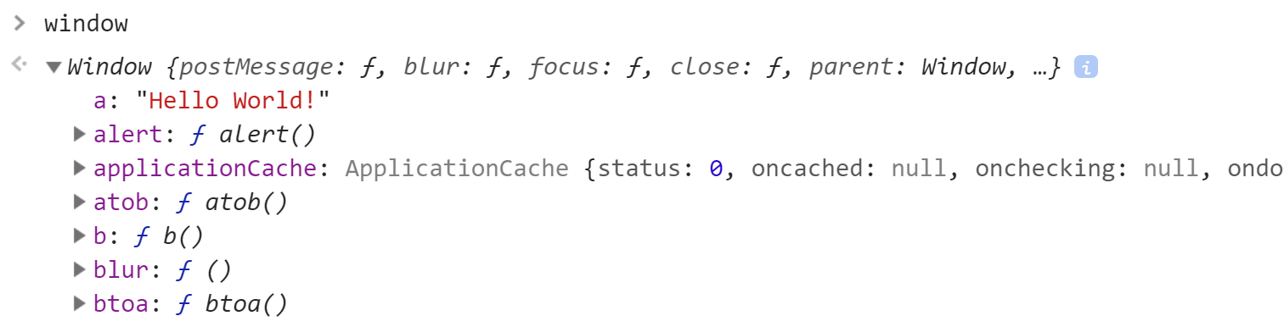
JS
Open your developer console and type window and then expand the window object. Try to find variable a and function b().
Since you declared these in global scope (i.e. not in a function), JavaScript created these objects for you as members of the window object in the global execution context. You can access these objects from anywhere in your code -- they are global.

Slide 10
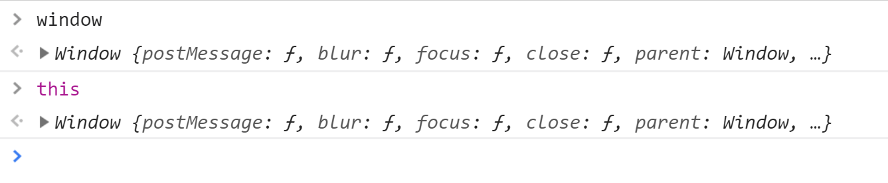
JS
Open your developer console and type the two commands below (window & this).
JavaScript created these objects for you even though you didn't write any code. This is the global execution context. It defines what is available in the global environment, before any functions are called.

Slide 11
JS
We can visualize our global execution context now. It will look something like this. Notice JavaScript has added our variable a and function b().
Global Execution Context
window The container for the document object model.
this
A reference to the window object.
outer scope
A reference to parent context, which is null.
variables and functions
var a, type string, current value undefined function b(), type function

Slide 12
When JavaScript builds an execution context, it does it in two steps. In the first step, it lifts all variable and function references to the top of the scope. This is called hoisting, and is unique to JavaScript.

Slide 13
JS
Modify your simple HTML page to add some console reporting as shown below. Before you run it, try to predict what it will produce.
<script>
"use strict"
var a = 'Hello World!';
function b() {
console.log('Function b was invoked!');
}
b();
console.log(a);
</script>
Notes:
JS_execution_context_2.html

Slide 14
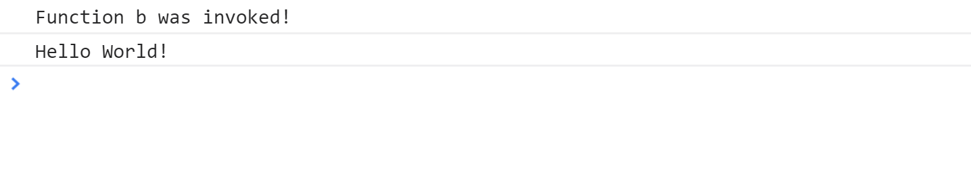
JS
In your developer console, you probably saw the following output, and hopefully that matched your prediction.
Now move the function invocation b() and the console.log(a) statements to the top of the script block, right after use strict. Refresh your page. You should get an error, right? Both the function and the variable are not yet declared when they are referenced. In most programming languages, this results in an error.

Slide 15
JS
Surprise! JavaScript does not report an error because it hoists the variable and function definitions to the top of the scope before executing any code.
<script>
"use strict"
b(); // No error reported, even though function b is not yet declared.
console.log(a); // Same deal here. No error, but a is undefined.
var a = 'Hello World!'; // Change var to let or const and try the code
function b() {
console.log('Function b was invoked!');
}
</script>

Slide 16
JS
Hoisting does not rewrite your code! All it means is that the execution context is aware of variables and functions in the current block before it actually executes any code.

Slide 17
JS
Whenever JavaScript creates the global execution context, it scans the block for variables and functions which are then
recorded in the context. This happens before any code is actually executed.
Global
1
Scan block for variables and functions.
window
this
outer
variables and functions
2
Reserve memory space in the execution context for variables and functions.

Slide 18
JS
Note that hoisting only reserves space for variables. It does not capture the value of a variable -- that happens when the code actually executes.
Global
window
this
outer
var a = 'Hello World!';
variable a, type string, value undefined

Slide 19
JS
JavaScript also records function definitions when it builds the execution context. It does not execute the function until it finishes scanning for variables and functions.
Global
window
this
outer
function b() { ... }
function b()

Slide 20
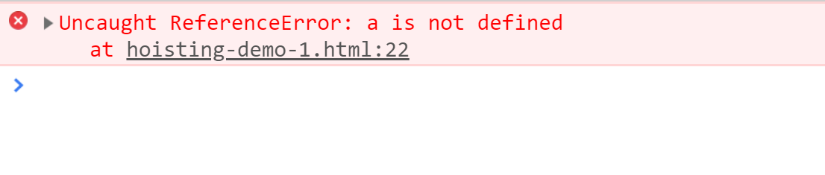
JS
Also remember that if a variable is not declared at all, it is
not defined, which is different than undefined. When JavaScript executes code in a block it expects to find all variables hoisted and declared. Otherwise: ReferenceError.
Global
window
this
outer
console.log(a);
BOOM!
variables and functions

Slide 21
JS
Q
What will this script report at the developer console?
"use strict"
console.log(a);
if (a === undefined) {
console.log("a is undefined");
} else {
console.log("a is defined");
}
Notes:
JS_execution_context_3.html

Slide 22
JS
Q
What will this script report at the developer console?
"use strict"
console.log(a);
if (a === undefined) {
console.log("a is undefined");
} else {
console.log("a is defined");
}
var a;
Notes:
JS_execution_context_3.html

Slide 23
JS
Q
What will this script report at the developer console?
"use strict"
console.log(a);
if (a === undefined) {
console.log("a is undefined");
} else {
console.log("a is defined");
}
var a = 1234;
Notes:
JS_execution_context_3.html

Slide 24
JS
Q
What will this script report at the developer console?
"use strict"
var a = 1234;
console.log(a);
if (a === undefined) {
console.log("a is undefined");
} else {
console.log("a is defined");
}
Notes:
JS_execution_context_3.html

Slide 25
JS
Q
What will this script report at the developer console?
"use strict"
function b() {
console.log("function b was invoked!");
}
b();
console.log(a);
var a = "Hi everybody!";
console.log(a);
console.log(c);
Notes:
JS_execution_context_4.html

Slide 26

JS
When we call a function in JavaScript, the engine creates a new execution context for us, then adds it to a stack on top of other execution contexts.

Slide 27
JS
We create functions a() and b() in global scope. Next, we call function a(), which calls function b(). What will the execution context stack look like?
function b() {
}
function a() {
b();
}
a();
?

Slide 28
JS
First, JavaScript creates a global execution context for us and parks it at the bottom of the stack. This context knows about functions a() and b().
function b() {
}
function a() {
b();
}
a();
Global Execution Context

Slide 29
JS
When JavaScript invokes function a(), it creates a brand new execution context and pushes it onto the execution context stack.
function b() {
}
function a() {
b();
}
a();
When this function is invoked, a new execution context is added to the stack.
function a()
Execution Context
Global Execution Context

Slide 30
JS
When JavaScript invokes function b(), it creates a brand new execution context and pushes it onto the execution context stack.
function b() {
}
function a() {
b();
}
a();
When function b() is invoked, a new execution context is added to the stack.
function b()
Execution Context
function a()
Execution Context
Global Execution Context

Slide 31
JS
Eventually, function b() finishes its job. At this point, JavaScript pops the execution context for function b() off the stack. The current execution context is now a().
function b()
Execution Context
function b() {
}
function a() {
b();
}
a();
When function b() completes, the execution context for b() is removed from the stack.
function a()
Execution Context
Global Execution Context

Slide 32
JS
Function a() eventually finishes too, and then JavaScript pops its execution context off the stack. The current execution context is back to global.
function a()
Execution Context
function b() {
}
function a() {
b();
}
a();
When function a() completes, the execution context for a() is removed from the stack.
Global Execution Context

Slide 33
JS
Now we are back where we started. The function a() has completed. We are in the global execution context again.
function b() {
}
function a() {
b();
}
a();
Global Execution Context

Slide 34
JS
JavaScript is very function-centric. Each function creates a little world of its own, with its local variables and nested functions.
JavaScript sets aside memory for variables that it finds inside a function each time that function is invoked.
This is the function's execution context.
Each function gets a private execution context.

Slide 35
References
https://www.freecodecamp.org/news/execution-context-how-javascript-works-behind-the-scenes
https://www.techtarget.com/whatis/definition/stack-overflow

Slide 36
Lesson 1.4
JS Array

Slide 37
Learning Outcomes
Use array in JS vs. other programming languages
Array built in methods to manipulate and process data
Use array and array methods in your JavaScript code to store and process data
Write a program integrating array to other JavaScript concepts you already learned

Slide 38
Arrays
Arrays are ordered collections of values under a single variable name.
Composite data type.
Also, a data structure.
Arrays can hold all types of data structures: strings, numbers, objects, functions, even other arrays.
const arr = [“abc”, 10, [1, 2, 3], myFunction];
The length of an array is the total number of elements in the array.
Each value is called an element.
Each value is identified by an index.
The index indicates the position of an element in an array.
Array indexes start at 0, and end at length – 1.
Can be used to identify an element.
Array elements can be accessed as array[index].

Slide 39
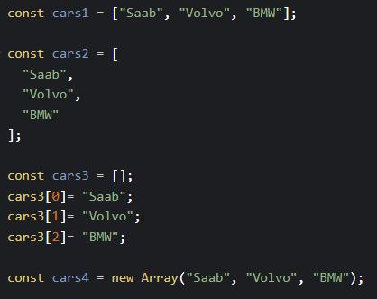
Creating Arrays
There are several ways to create an array in JavaScript.
It is a common practice to declare arrays with the const keyword.
Using const does not define a constant array. It defines a constant reference to an array.
You can still add, edit, and remove elements of a constant array.
However, you cannot reassign the variable.

Slide 40
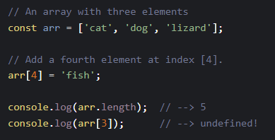
Arrays
JavaScript arrays can be sparse. This means they can have holes in them. This is different from many languages.
}
[0] cat
[1] dog
[2] lizard
[3] undefined
[4] fish
length is 5

Slide 41
Arrays vs Objects
Arrays are a special kind of object.
The typeof operator in JavaScript returns "object" for arrays.
Arrays use numbered indexes.
const person = ["John", "Doe", 46];
person[0] → “John”
Objects use named indexes.
const person = {firstName: "John", lastName: "Doe", age: 46};
person.firstName → “John”

Slide 42
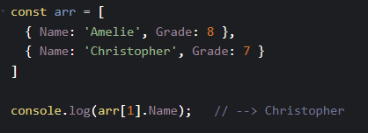
Arrays of Objects
It is very common to see JavaScript arrays of objects.
In fact, most API calls work this way since they usually return collections of things (e.g. tables, rows, datasets).

Slide 43
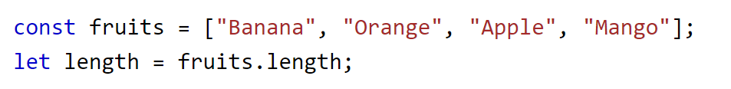
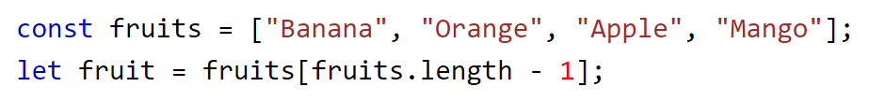
Array Properties
Because arrays are objects, they have properties and methods.
The real strength of JavaScript arrays are the built-in array properties and methods.
The length property of an array returns the length of an array (the number of array elements).
The length property is always one more than the highest array index.

Slide 44
Array Iteration
To traverse an array, the best practice is to use the built-in iterator methods.
Do not use for or for…in.
for…of is okay.
Example: https://codepen.io/michael-dorsey/pen/RwdKbjW
Iterator Methods:
forEach()
Executes a provided callback function once for each array element
Callback function takes 3 arguments: item value, item index, array itself
Example: https://codepen.io/michael-dorsey/pen/PoLOvra
map()
Creates a new array by performing a function on each array element
Does not change the original array
reduce()
Runs a function on each array element to reduce it to a single value.
Does not change the original array
every()
Checks if all array values pass a test
some()
Checks if some array values pass a test

Slide 45
Common Array Methods
Destructive* vs. Non-destructive Methods
Destructive methods change the contents of the original array after being called.
Non-destructive methods make a duplicate of the original array rather than altering it.
Adding elements to an array
push() *
unshift() *
Removing elements from an array
pop() *
shift() *
Adding or Removing Elements at Any Position
splice() *

Slide 46
Common Array Methods
Extracting a subarray
slice()
Merging arrays
concat()
Searching inside arrays
indexOf()
lastIndexOf()
includes()
find()
findIndex()
filter()

Slide 47
Common Array Methods
Sorting an array
sort() *
reverse() *
Convert an array to a string
toString()
join()
* Destructive methods

Slide 48
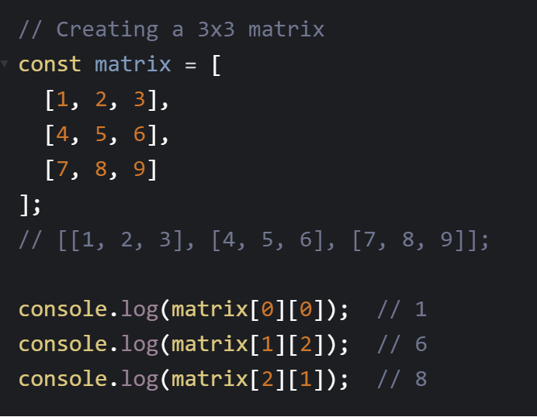
Multidimensional Arrays
Multidimensional arrays are useful for representing grid-like structures, matrices and tables.

Slide 49
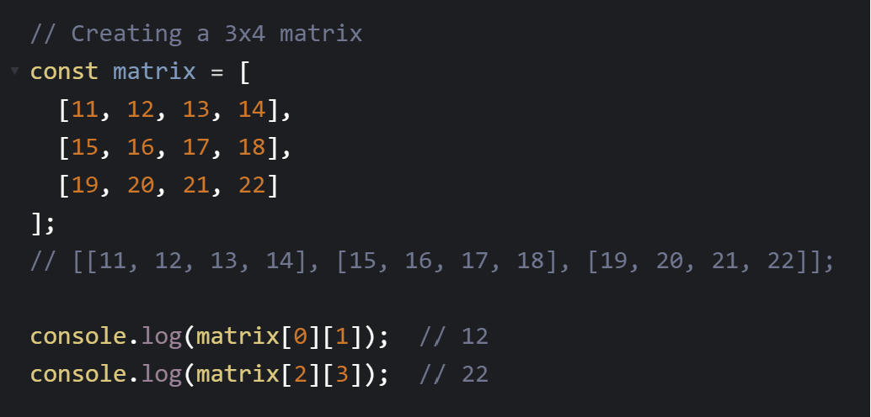
Multidimensional Arrays

Slide 50
Arrays are powerful
You should be aware of all the array methods and when its best to use them.
Generally, use the most powerful method for the job and avoid writing your own.

Slide 51
Array Methods Practice
Solve the 7 given questions.
https://codepen.io/michael-dorsey/pen/eYXyQYO

Slide 52
Assessments
GLA 1
In-class test on July 16, 8:00am.
Worth 10% of your grade.
Covers Module 1, Lessons 1-4.
Open notes, open internet.
No AI tools allowed.
Assignment 1
Worth 15% of your grade.
Covers Modules 1 and 2.
Due by July 25, 8:00am.

Slide 53
Assessments
Group Project
Group members have been posted.
Worth 30% of your grade.
Final submission due by August 22, 11:59pm.
In-class presentation on August 22, 8:00am.
You already possess all the skills necessary to complete Phase 1: HTML, CSS, forms, arrays, objects, validation. So start now!
There will be weekly check-ins at the end of class on Thursdays.
What did your team accomplish since our last check-in?
What will your team accomplish by the next check-in?

Slide 54
For next class
Prepare for GLA 1.
Assessments Reminder:
Quiz 1 due July 16, 8:00am.
GLA 1 will be an in-class test on July 16, 8:00am.
Assignment 1 due July 25, 8:00am.
Group Project due August 22, 11:59pm.
All assessment dates have been posted in D2L.
See the “Assignments Policy” for late submission procedures.

Slide 55
References
https://www.w3schools.com/js/js_arrays.asp
https://www.w3schools.com/js/js_array_const.asp

